Slide 1
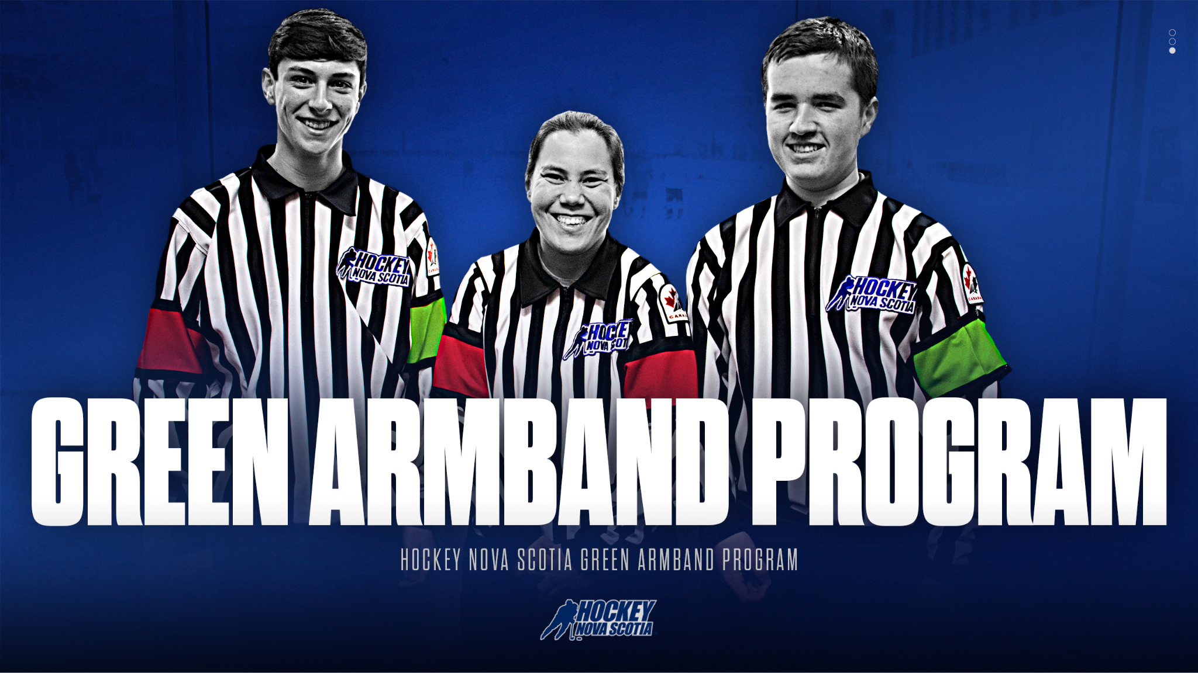

Slide 2
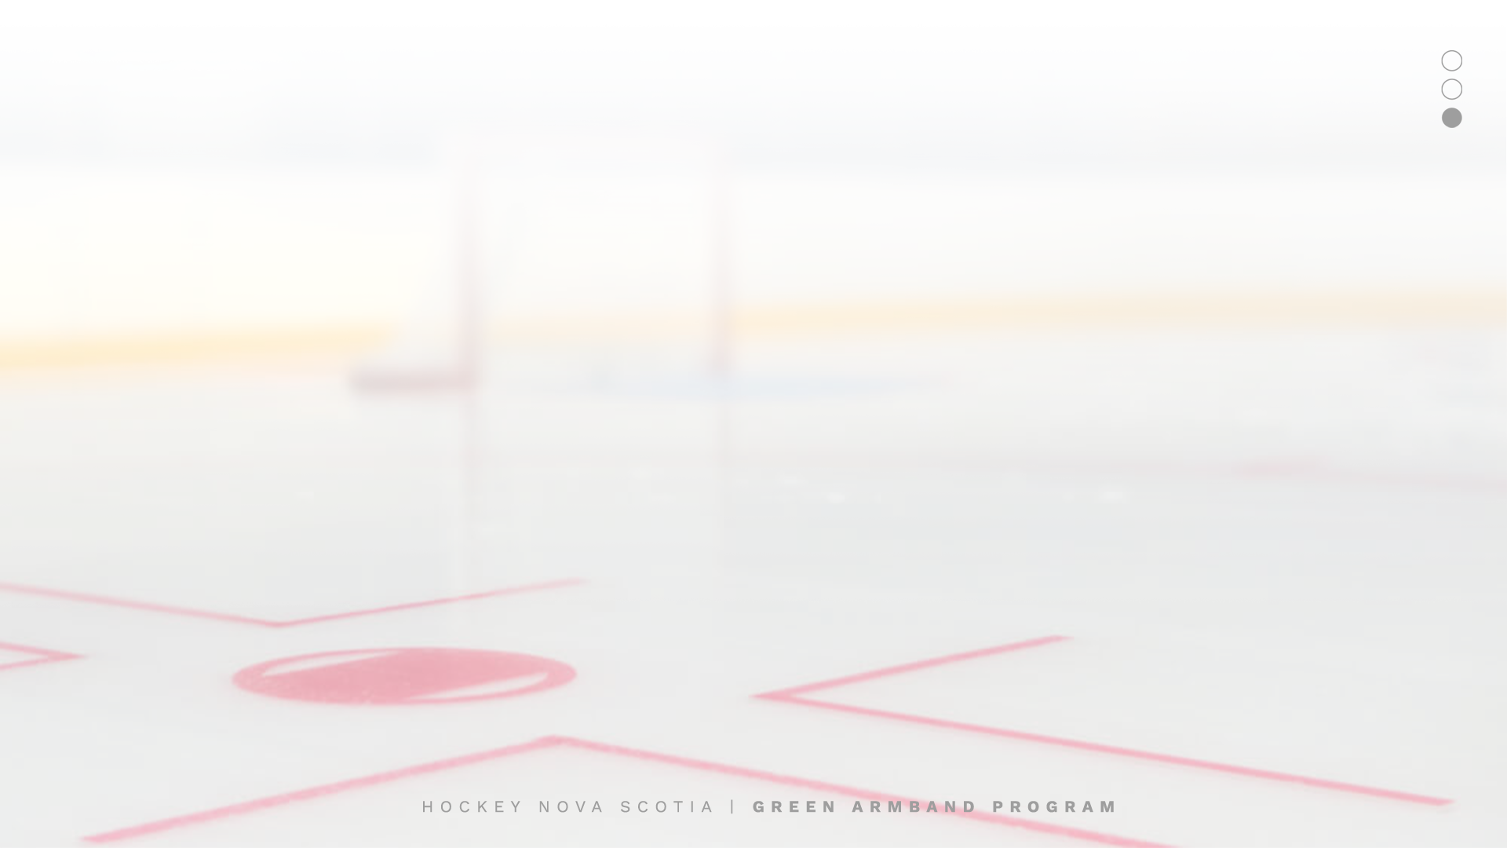
GREEN ARMBAND INITIATIVE
History
Objectives
Green Armband Initiative
Why Are We Doing This?
Next Steps
Contacts

Slide 3

HISTORY
Introduced in Montreal and Quebec City in January 2020 following a similar program implemented in the Montreal baseball program.
Requires all officials under the age of 18 to wear green armband on left arm for all their games regardless of whether they are working as a referee or linesperson.
All first-year officials (18 years and older) were also required to wear green armband.

Slide 4

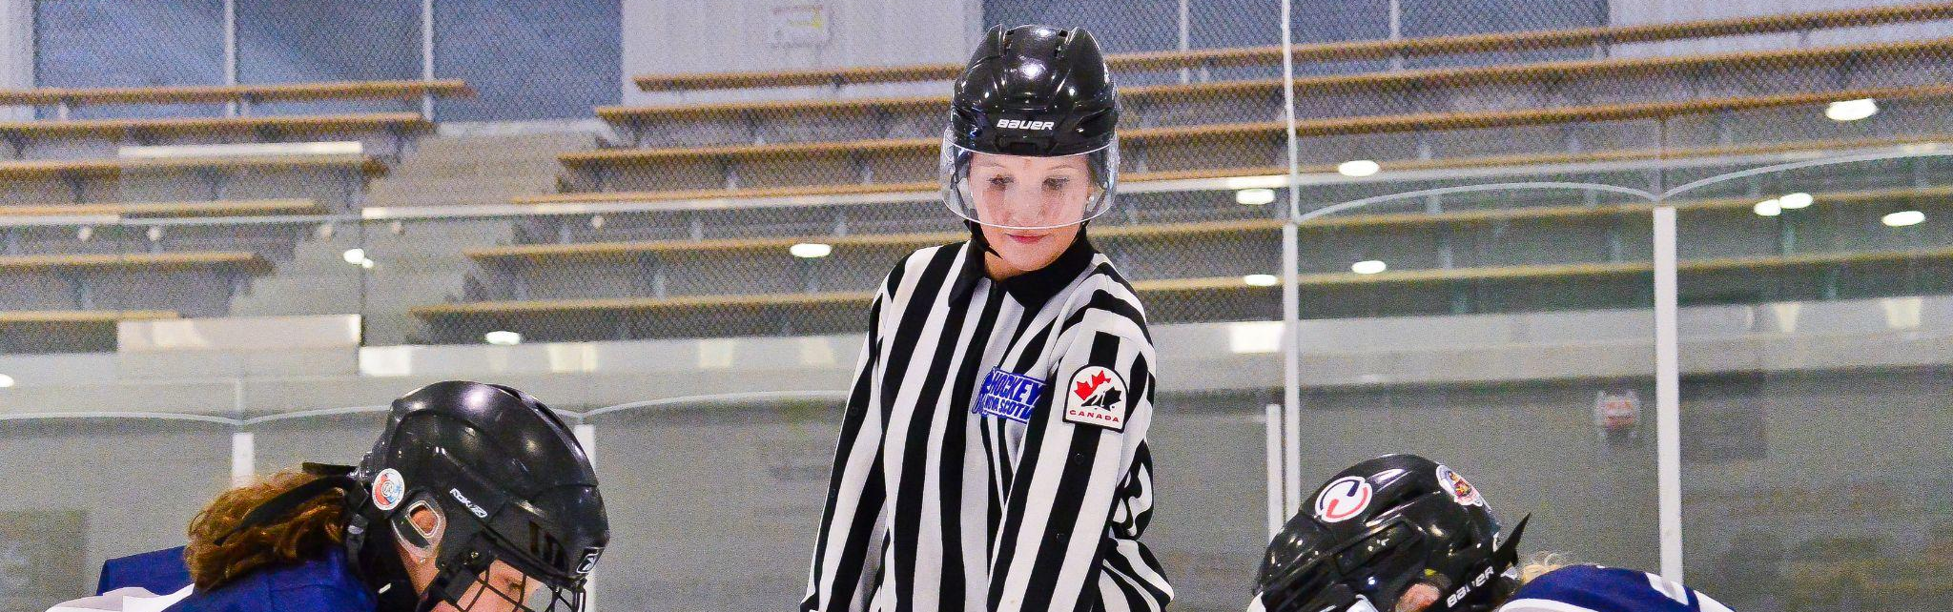
OBJECTIVES
Reduce harassment and abuse of younger on-ice officials by clearly identifying them as minors to coaches, parents, players, and league officials
Educate coaches, parents, players, and league officials about the challenges officials face with respect to harassment and abuse while officiating minor hockey games

Slide 5

GREEN ARMBAND INITIATIVE
All officials below the age of 18 will wear one green armband on their left arm during all games to identify these officials as minors to team officials, spectators, and parents.
Education campaign to promote initiative and raise awareness about harassment and abuse of officials across HNS.

Slide 6
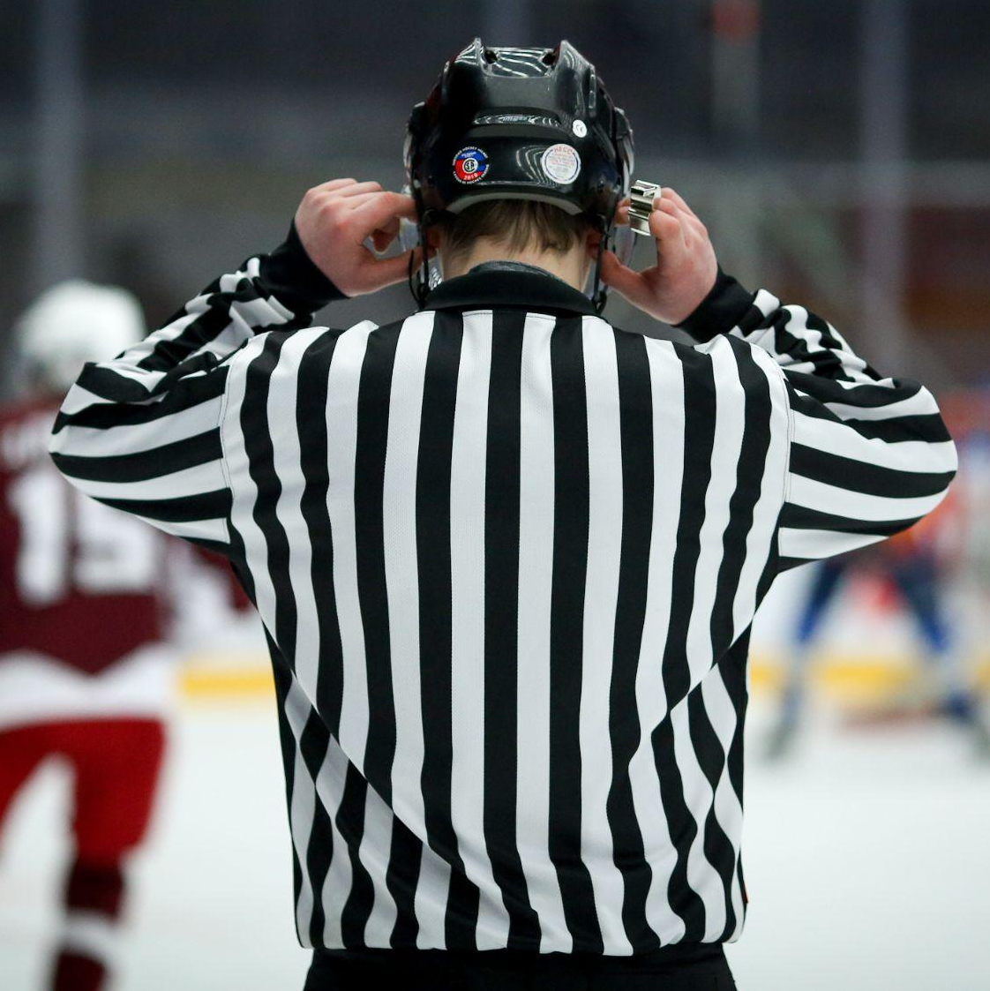
WHY ARE WE DOING THIS?
Right thing to do to protect the psychological and physical safety of minor officials.
Like many branches across Canada, recruitment and retention of officials continues to be a challenge.
Over 40% of all Hockey Nova Scotia officials are under the age of 18 and work a large portion of all
minor hockey games in the Association.
1 out of every 3 officials quit after their first year. Over half quit after two years and 65% are no longer officials after 3 years.
Officials cite harassment and abuse as a reason why they have decided to quit officiating.

Slide 7
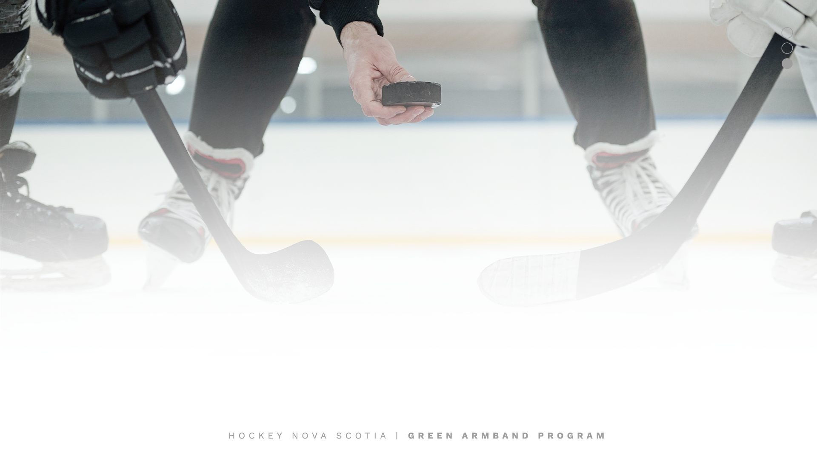
NEXT STEPS
Promotion of initiative across the Association (officials, coaches, association executives, parents, players, etc.) through poster campaign, presentations, media interviews, etc. as a means to increase awareness of challenges faced by officials and educate members of the hockey community about how they can help.
Respond to questions about initiative.

